Slide 1
Hadoop Library from Apache
Introduction
Architecture of MapReduce in Hadoop
Running a Job in Hadoop

Slide 2
INTRODUCTION
Hadoop - open source implementation of MapReduce.
Coded and released - in Java (rather than C) by Apache.
Hadoop implementation of MapReduce uses Hadoop Distributed File System (HDFS) as its underlying layer rather than GFS.
The Hadoop core is divided into two fundamental layers:
MapReduce engine & HDFS.
MapReduce engine is the computation engine running on top of HDFS as its data storage manager.

Slide 3
HDFS: HDFS is a distributed file system - organizes files & stores their data on a distributed computing system.
HDFS Architecture: HDFS has a master/slave architecture containing a single NameNode (master) & a number of DataNodes (slaves).
To store a file in this architecture, HDFS splits the file into fixed-size blocks (e.g., 64 MB) and stores them on workers (DataNodes).
The mapping of blocks to DataNodes is determined by the NameNode.
The NameNode (master) also manages the file system’s metadata and namespace.
Each DataNode is responsible for storing and retrieving its file blocks.

Slide 4
HDFS Features:
Distributed file systems have special requirements, such as performance, scalability, concurrency control, fault tolerance, and security requirements, to operate efficiently.
However, as HDFS is not a general-purpose file system, it does not need all the requirements of a general distributed file system.
For example, security has never been supported for HDFS systems.
The following are two important characteristics of HDFS that distinguish it from other generic distributed file systems.
HDFS Fault Tolerance: One of the main aspects of HDFS is its fault tolerance characteristic.
Since Hadoop is designed to be deployed on low-cost hardware by default, a hardware failure in this system is considered to be common rather than an exception.

Slide 5
Therefore, Hadoop considers the following issues to fulfill reliability requirements of the file system :
• Block replication To reliably store data in HDFS, file blocks are replicated in this system. The replication factor is set by the user and is three by default.
• Replica placement The placement of replicas is another factor to fulfill the desired fault tolerance in HDFS.
Cost of communication between two nodes in different racks is relatively high in comparison with that of different nodes located in the same rack.
Therefore, sometimes HDFS compromises its reliability to achieve lower communication costs.
• Heartbeat and Blockreport messages Heartbeats and Blockreports are periodic messages sent to the NameNode by each DataNode in a cluster.
Receipt of a Heartbeat implies that the DataNode is functioning properly,
Each Blockreport contains a list of all blocks on a DataNode.
NameNode receives such messages because it is the sole decision maker of all replicas in the system.

Slide 6
HDFS High-Throughput Access to Large Data Sets (Files):
Because HDFS is primarily designed for batch processing rather than interactive processing, data access throughput in HDFS is more important than latency.
Also, because applications run on HDFS typically have large data sets, individual files are broken into large blocks (e.g., 64 MB) to allow HDFS to decrease the amount of metadata storage required per file.
This provides two advantages:
1. List of blocks per file will shrink as the size of individual blocks increases,
2. By keeping large amounts of data sequentially within a block, HDFS provides fast streaming reads of data

Slide 7
HDFS Operation:
• Reading a file: User sends an “open” request to the NameNode to get the location of file blocks.
For each file block, the NameNode returns the address of a set of DataNodes containing replica information for the requested file.
Upon receiving such information, the user calls the read function to connect to the closest DataNode containing the first block of the file.
After the first block is streamed from the respective DataNode to the user, the established connection is terminated and the same process is repeated for all blocks of the requested file until the whole file is streamed to the user.

Slide 8
• Writing to a file: User sends a “create” request to the NameNode to create a new file in the file system namespace.
If the file does not exist, the NameNode notifies the user and allows him to start writing data to the file by calling the write function.
The first block of the file is written to an internal queue termed the data queue while a data streamer monitors its writing into a DataNode.
Since each file block needs to be replicated by a predefined factor, the data streamer first sends a request to the NameNode to get a list of suitable DataNodes to store replicas of the first block.
The steamer then stores the block in the first allocated DataNode.
Afterward, the block is forwarded to the second DataNode by the first DataNode.
The process continues until all allocated DataNodes receive a replica of the first block from the previous DataNode.
Once this replication process is finalized, the same process starts for the second block and continues until all blocks of the file are stored and replicated on the file system.

Slide 9
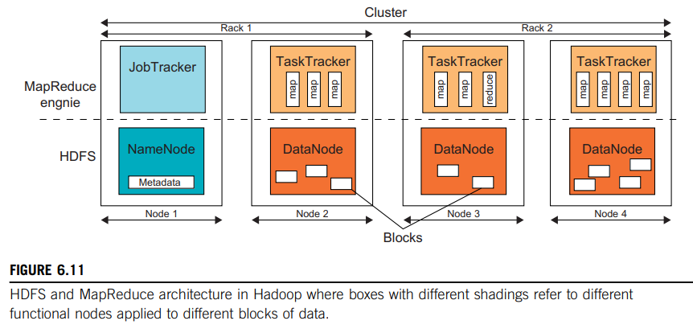
ARCHITECTURE OF MAPREDUCE IN HADOOP
Topmost layer of Hadoop is MapReduce engine that manages the data flow and control flow of MapReduce jobs over distributed computing systems.
Figure 6.11 shows the MapReduce engine architecture cooperating with HDFS.

Slide 10
Similar to HDFS, the MapReduce engine also has a master/slave architecture consisting of a single JobTracker as the master and a number of TaskTrackers as the slaves (workers).
The JobTracker manages the MapReduce job over a cluster and is responsible for monitoring jobs and assigning tasks to TaskTrackers.
The TaskTracker manages the execution of the map and/or reduce tasks on a single computation node in the cluster.
Each TaskTracker node has a number of simultaneous execution slots, each executing either a map or a reduce task.
Slots are defined as the number of simultaneous threads supported by CPUs of the TaskTracker node.
Ex: A TaskTracker node with N CPUs, each supporting M threads, has M * N simultaneous execution slots.

Slide 11
RUNNING A JOB IN HADOOP
Three components contribute in running a job in this system:
a user node, a JobTracker, and several TaskTrackers.
The data flow starts by calling the runJob(conf) function inside a user program running on the user node, in which conf is an object containing some tuning parameters for the MapReduce framework and HDFS.
The runJob(conf) function and conf are comparable to the MapReduce(Spec, &Results) function and Spec in the first implementation of MapReduce by Google.
Figure 6.12 depicts the data flow of running a MapReduce job in Hadoop.

Slide 12
